Slide 1

Solar Investigations Project
Joe Flanagan, Lizzie Crawford, Iain Menzies

Slide 2
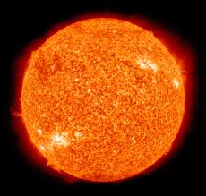
Background – The Sun
The sun is a G type main sequence star with a surface temperature of around 5578K.
The sun was formed around 4.567 billion years ago.
It is made up of approximately ¾ hydrogen, ¼ helium and 1.69% heavier elements, such as oxygen, carbon, neon and iron.

Slide 3
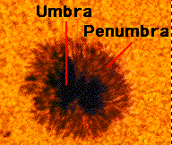
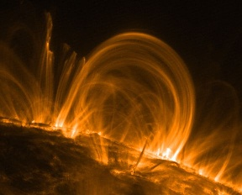
Background – Sunspots
Sunspots are parts of the sun that are cooler than the surrounding area, due to the sun’s magnetic field.
They often appear in pairs, with the magnetic field coming out of one sunspot and into another oppositely charged sunspot.
Solar flares are intense bursts of radiation that are sometimes emitted from sunspots.
Sunspots
Arc

Slide 4
Background - Observing the sun safely
In order for us to be able to look at the sun safely, we need to filter out 99% of its light before it reaches our eyes.
Ways to do this include;
using a pinhole projection box
shining the light from the sun through a pair of binoculars onto a screen
using a solar telescope or solar observation glasses
using a filter
Notes:
Such as the h-alpha filter used to take the images in our project

Slide 5
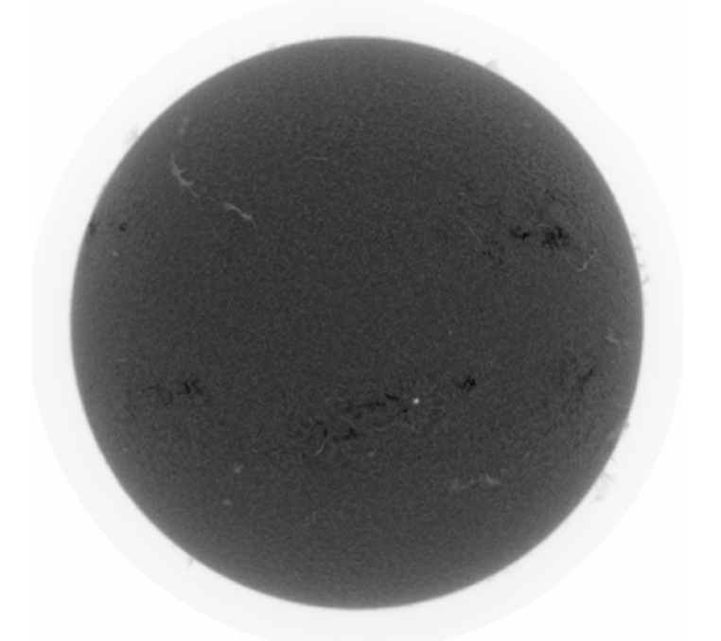
Target
To determine the rotational period of the sun using sunspot data
To investigate one hundred years of sunspot data to see if any patterns emerge.

Slide 6
Dataset
One hundred years of sunspot data
We were given over 100 years of sunspot data, from 1900 to 2008. This detailed the date that the reading was taken and the number of sunspots.
Determining the rotational period of the sun
We received 50 images of the sun from the GONG solar telescope, which were taken every day, as close to noon as possible.

Slide 7
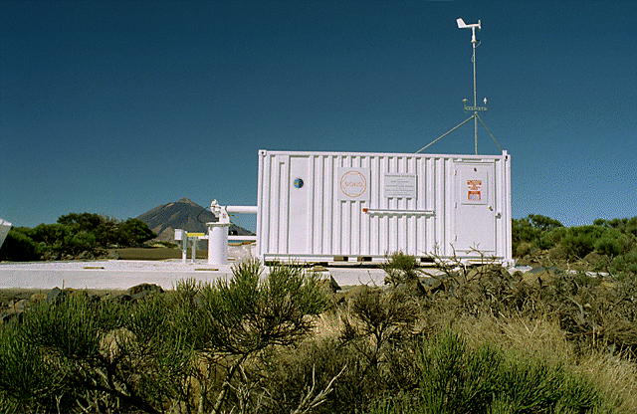
GONG
The GONG (Global Oscillation Network Group) solar telescope in Tenerife is one of six identical stations around the world.
These make up a community-based program to conduct a detailed study of solar internal structure and dynamics.
El Teide Observatory, Canary Islands

Slide 8
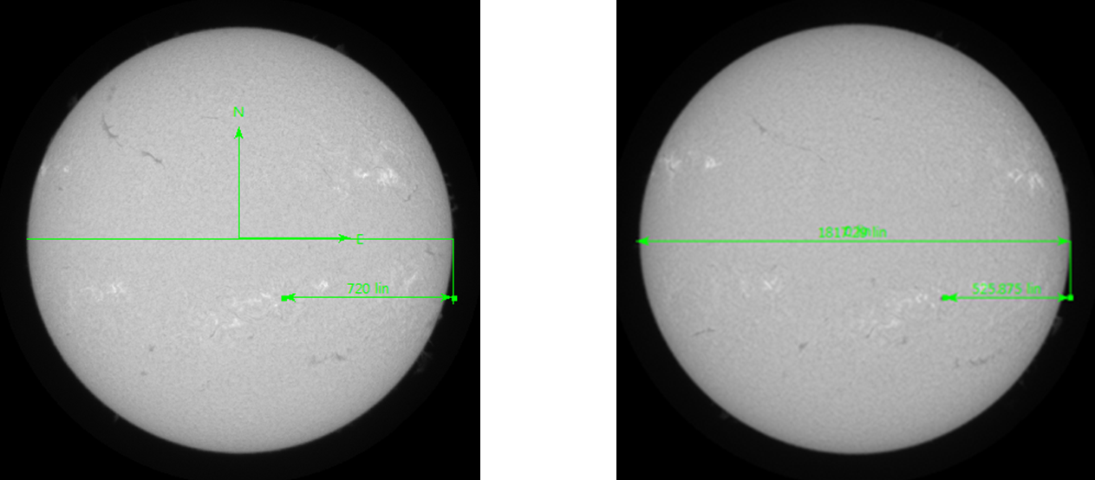
Determining the period of the sun using sunspots
Image 1
Image 2
Firstly we measured the diameter of the sun. This came to 1800.31 lin.
We then measured the distance from the sunspot to the edge of the diameter. This came to 720 lin in image 1 and 525.875 lin in image 2.

Slide 9
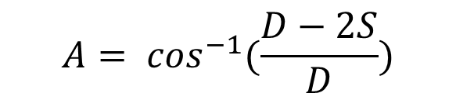
Determining the period of the sun using sunspots
$$A= \cos^{−1}(\frac{D−2S}{D})$$
We then put these values in to this equation in place of S, and the diameter in place of D.
This gave us values of A of 78.45⁰ and 65.43⁰
A₁ - A₂ = 13.02⁰
360⁰ ÷ 13.02⁰ = 27.65 Days
Notes:
A1 – A2 gave us the difference between the angles. This also gave us the angle changed in 24 hrs because the pictures were exacxtly 24 hrs apart. we devided 360 by this angle to get the time of one whole rotation.

Slide 10
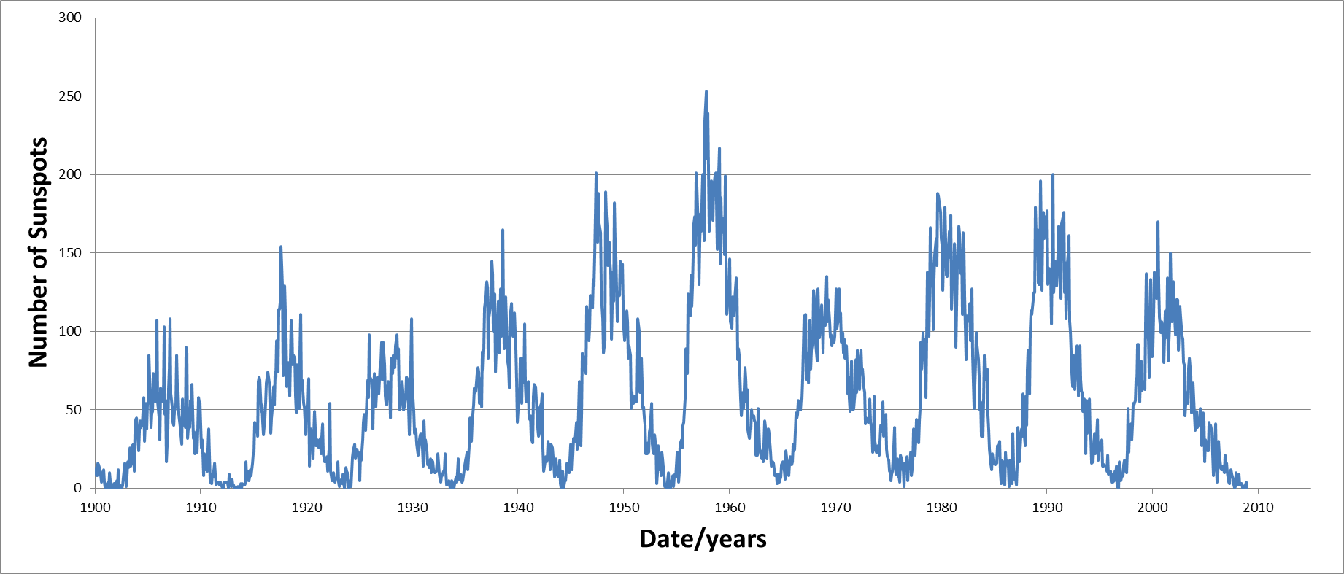
Investigating patterns in sunspot data
6
5
9
8
4
10
2
7
1
3
Firstly we plotted a graph of the number of sunspots against the date.

Slide 11
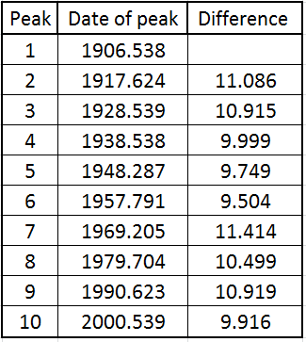

Investigating patterns in sunspot data
$\overline{x}$ = 10.445
From the graph, we took the date of the middle of each peak. We then found the difference between each set of consecutive values. Then we took the mean of these, giving 10.45 years. This shows that the sunspot cycle repeats every 10.45 years.

Slide 12

Conclusion
The sunspot cycle repeats every 10.45 years.
The rotational period of the sun at the latitude we measured is 27.65 days.

Slide 13
Any questions?

